Slide 1

Chapter 9 Part II
Maintainability
9.4 System Repair Time
9.5 Reliability Under Preventive Maintenance
9.6 State-Dependent Systems with Repair
Chapter 9
Notes:
If a failed component can be restored to an operating condition, then the analysis of its downtime is of interest. The time to restore or repair a failed component is a measure of its maintainability. Systems, components, and products may be restored to “as good as” condition, may experience “minimal repair,” or something in between.

Slide 2
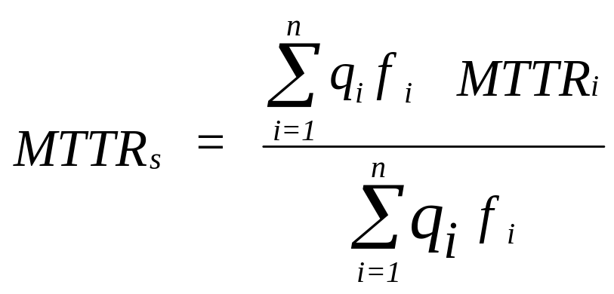
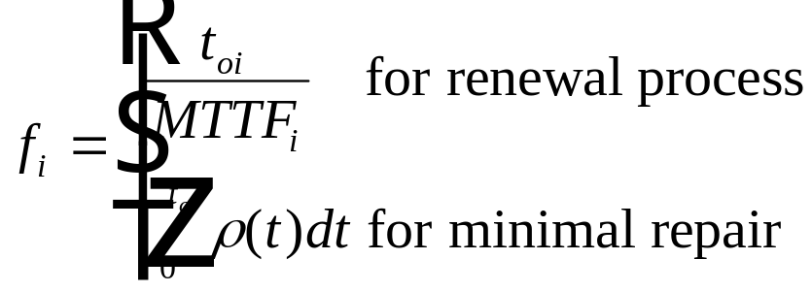
9.4 System Repair Time
MTTR_{i} = the mean time to repair the ith unique subsystem,
f_{i} = the expected number of failures of the ith unique subsystem
over the system design life,
q_{i} = the number of identical subsystems of type i,
Chapter 9
Notes:
The system MTTR is a weighted average of the MTTR of each of the subsystems with the weights being the relative fraction of failures of each subsystem.

Slide 3
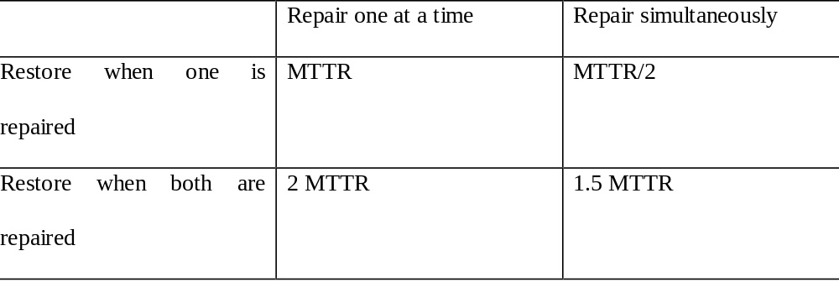
Redundant System Repair Time
A 2 out of 3 redundant system with each component
having a constant repair rate equal to 1/MTTR.
system mean repair time
Chapter 9
Notes:
Under redundancy, the system MTTR depends upon the maintenance concept.

Slide 4
System MTTR Derivation Under Simultaneous Repair
Case: Restore when one is repaired and repair simultaneously
Assume: r = 1/MTTR and independent repair times
T₁ = the time to repair component 1 and T₂ = the time to repair component 2
T = a random variable, the time of the first repair; T = minimum {T₁, T₂}
Pr{T ≤ t } = Pr{ T₁ ≤ t or T₂ ≤ t}
= Pr{T₁ ≤ t} + Pr{ T₂ ≤ t} - Pr{T₁ ≤ t} Pr{ T₂ ≤ t}
Under CFR, then Pr{T_{i} ≤ t } = 1 – Exp(-rt) and
Pr{T ≤ t }= 2 [1 – Exp(-rt)] - [1 – Exp(-rt)]²
= 2 – 2 exp(-rt) – [ 1 – 2Exp(-rt) + Exp(-2rt) ] = 1 – Exp(-2rt)
which is exponential with rate 2r and MTTR_{s} = 1/(2r) = MTTR /2
Chapter 9

Slide 5
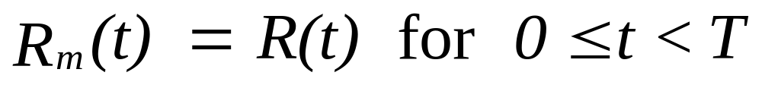
9. 5 Reliability under Preventive Maintenance
R(t) = system reliability without maintenance
T = interval of time between preventive maintenance
R_{m}(t) = reliability of the system with preventive maintenance
Prob of surviving n
PM intervals of length T
Repair to “as good as new”
Chapter 9
Notes:
The reliability of the system under preventive maintenance (PM) can be determined assuming that PM restores the system to “as good as now.”

Slide 6
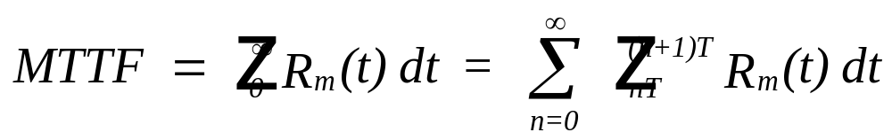
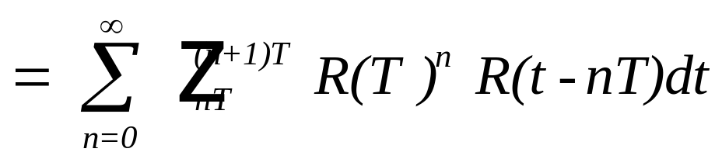
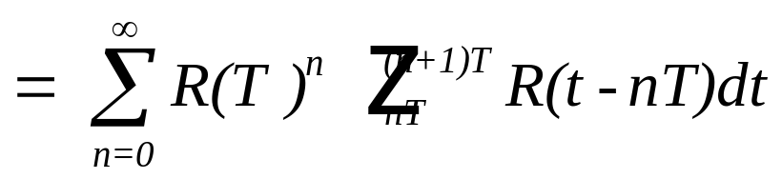
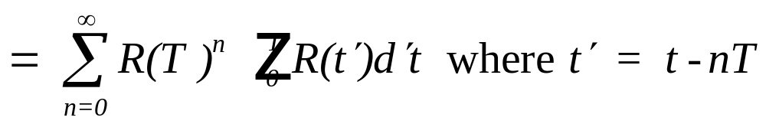
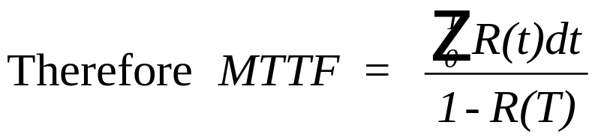
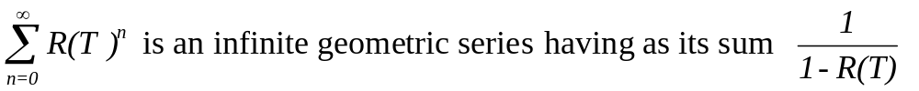
Reliability under Preventive Maintenance
Chapter 9
Notes:
The MTTF under PM may be found using the reliability function if the value of the definite integral in the numerator can be found.

Slide 7
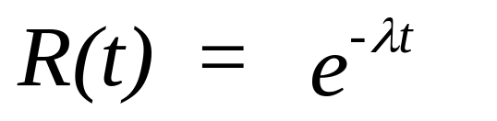
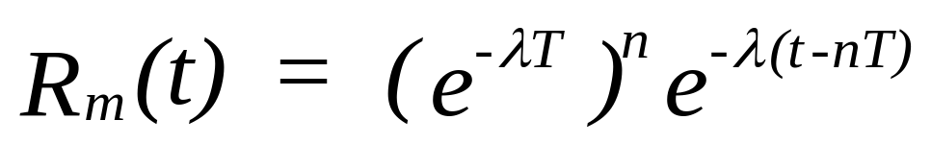
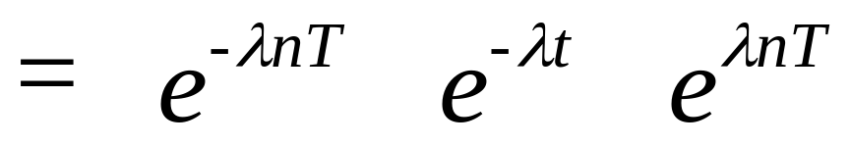
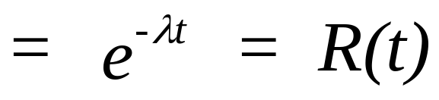
CFR Model
Another example of the memoryless property
of the Exponential Distribution.
Chapter 9
Notes:
For a CFR, preventive maintenance does not have any impact upon the reliability. If failures are externally generated, why do preventive maintenance?

Slide 8
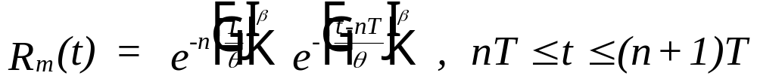
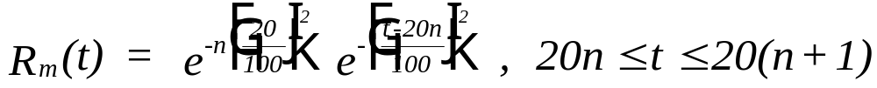
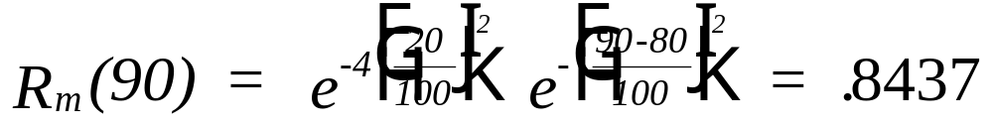
Weibull Example
numerical example
To find R_{m}(90), observe that n = 4. Then
Chapter 9
Notes:
For the Weibull failure distribution, preventive maintenance improves reliability when the failure rate is increasing. Why? What is R(90)?

Slide 9
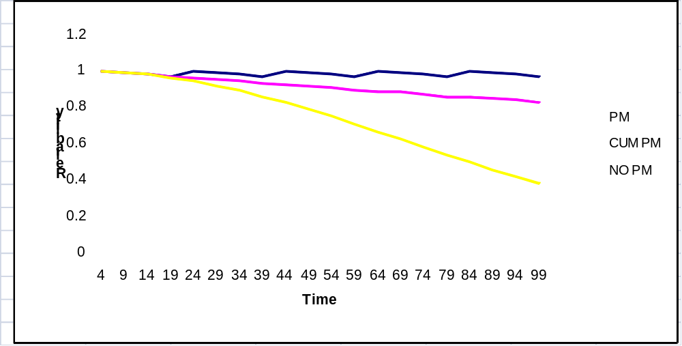
Weibull Example
Chapter 9
Notes:
The top line represents only the immediate impact on reliability under PM. The Cumulative PM curve is the actual reliability, R_{m}(t), under PM from time 0. It would be compared to the bottom curve which is R(t).

Slide 10
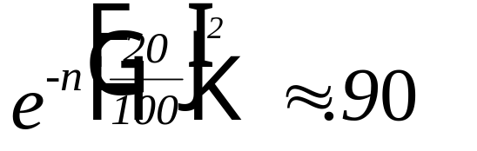
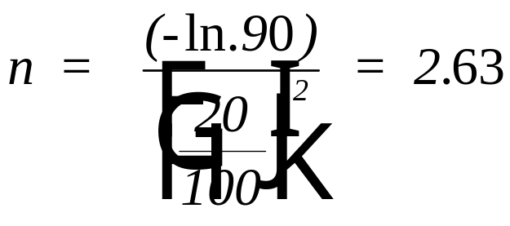
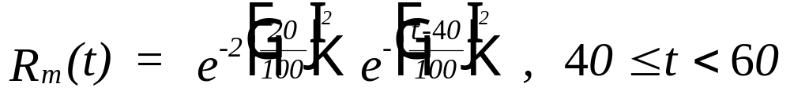
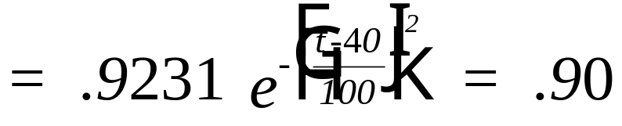
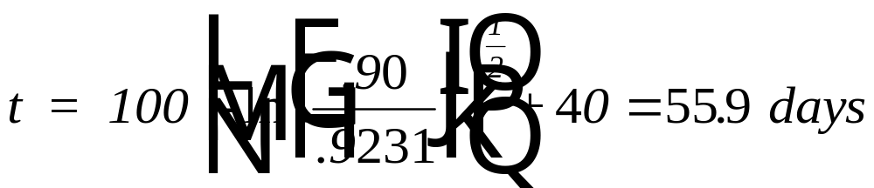
Weibull Example
Find the .90 design life:
Chapter 9
Notes:
With the PM interval specified, a design can be found by first determining the number of complete preventive maintenance intervals, n, and then finding the remaining time, t.

Slide 11
Maintenance-induced Failures
Chapter 9
Notes:
The PM model may be expanded to include maintenance induced failures. If p is the probability of a maintenance induced failure during a single PM, then (1-p) is the probability of no maintenance induced failures during a single PM. After n maintenance intervals, (1-p)^{n} is the probability of no maintenance induced failures occurring.

Slide 12
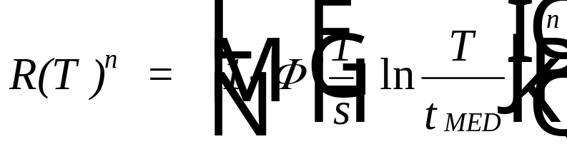
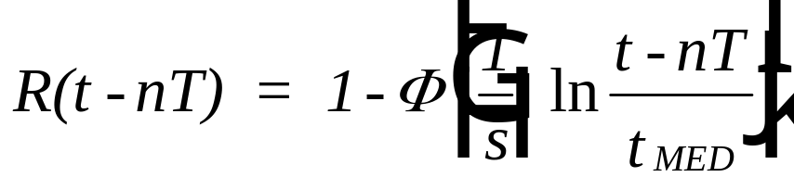
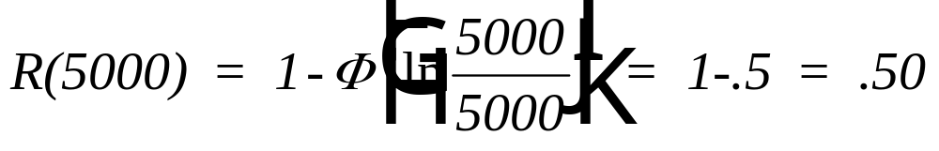
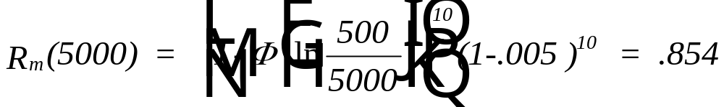
Maintenance-induced Failures - lognormal example
With t_{med} = 5,000 hr and s = 1.0:
Assume p = .005 and T = 500 hr.
Chapter 9
Notes:
An example of the expanded model with the lognormal as the failure distribution.

Slide 13
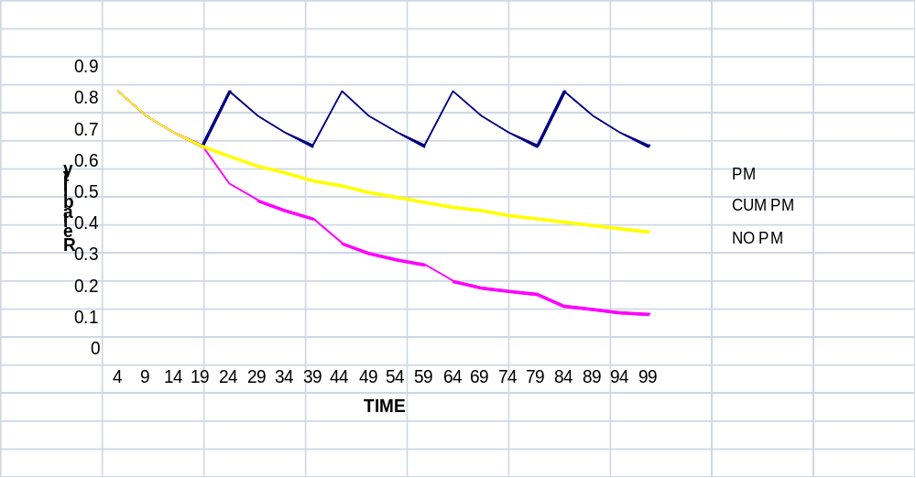
DFR and PM
Weibull with beta = 0.5 and theta = 100 days
Chapter 9
Notes:
A Weibull failure distribution with a decreasing failure rate. Notice how PM reduces the reliability. Why?

Slide 14

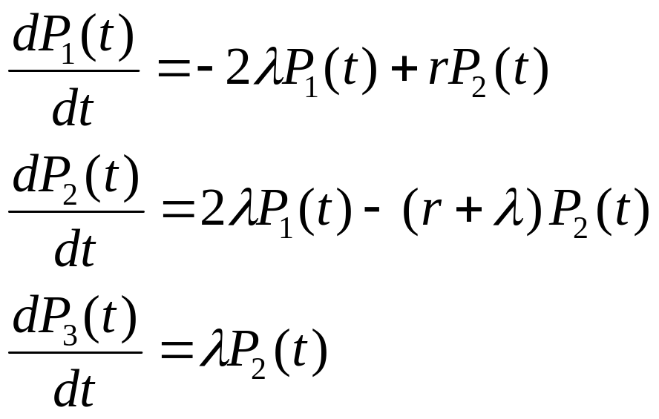
9.6 State Dependent Systems with Repair
2
1
2
3
r
Chapter 9
Notes:
The Markov Analysis techniques presented in Chapter 6 can be expanded to include situations in which repair can return the system to a prior state. In this example, there are two identical redundant components having a CFR and an exponential repair time with repair rate of r. If one component fails, there is some probability that it can be repaired before the second component fails thereby returning the system to state 1. The rate diagram and the resulting equations are shown.

Slide 15
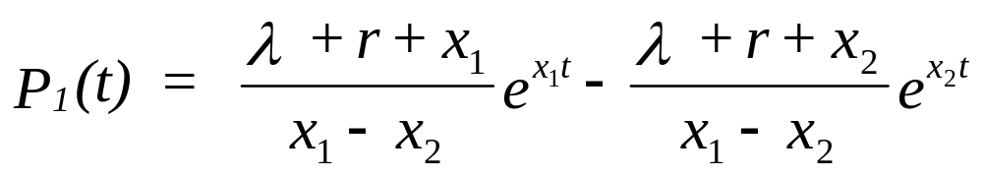
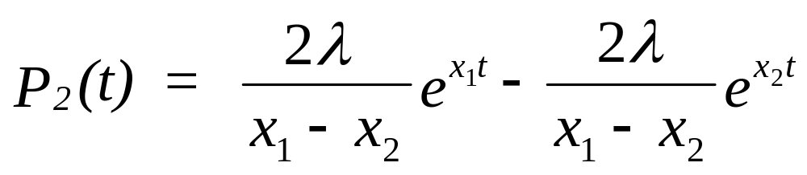
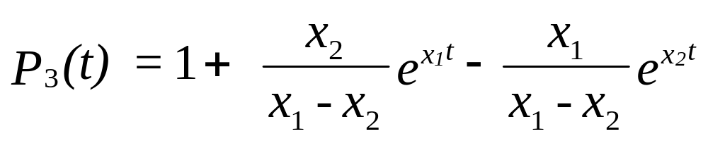
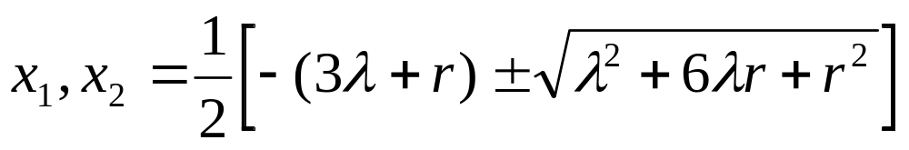
State Dependent Systems with Repair - solution
where
Chapter 9
Notes:
The solution to the system of differential equations can be found using Laplace transforms. Only the solution is shown here.

Slide 16
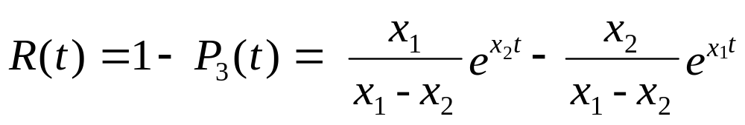
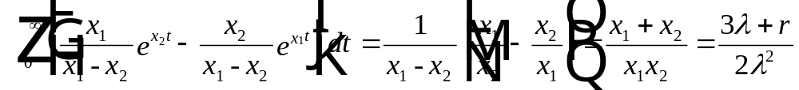

State Dependent Systems with Repair - solution
MTTF =
Chapter 9
Notes:
The system reliability is the probability of being in states 1 or 2 which is equal to 1 – P₃(t). Integrating R(t) gives the system MTTF where MTTF_{c} = 1/lambda and MTTR_{c} = 1/r. What happens to the MTTF as the MTTR decreases?

Slide 17
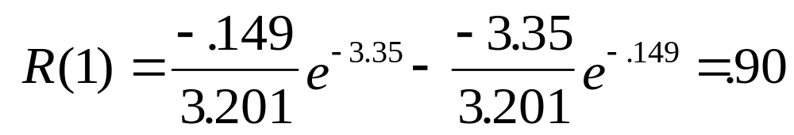
State Dependent Systems with Repair - example
A computer system consists of two active parallel processors
each having a constant failure rate of .5 failures per day.
Repair of a failed processor requires an average of one half a
day (exponential distribution).
MTTF = [3(.5) + 2 ] / [(2) (.25)] = 7 days.
where x₁ = -0.149 and x₂ = -3.35
without repair, MTTF = 3 days and R(1) = .845
Chapter 9
Notes:
For this example, duplicate the calculations.

Slide 18
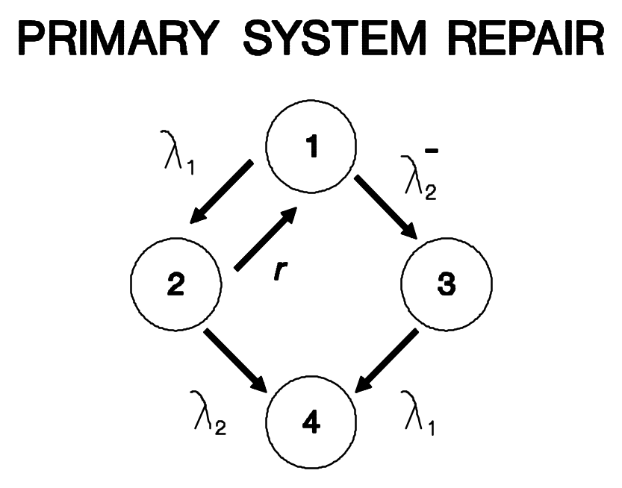
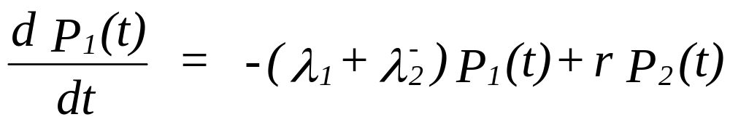
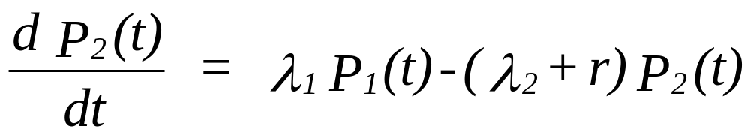
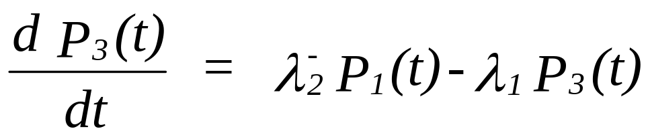
Standby System with Repair
Chapter 9
Notes:
A variation on the previous model, assumes that the second component is in standby. If the primary component fails, it may be repaired before the standby unit (now operating) fails.

Slide 19
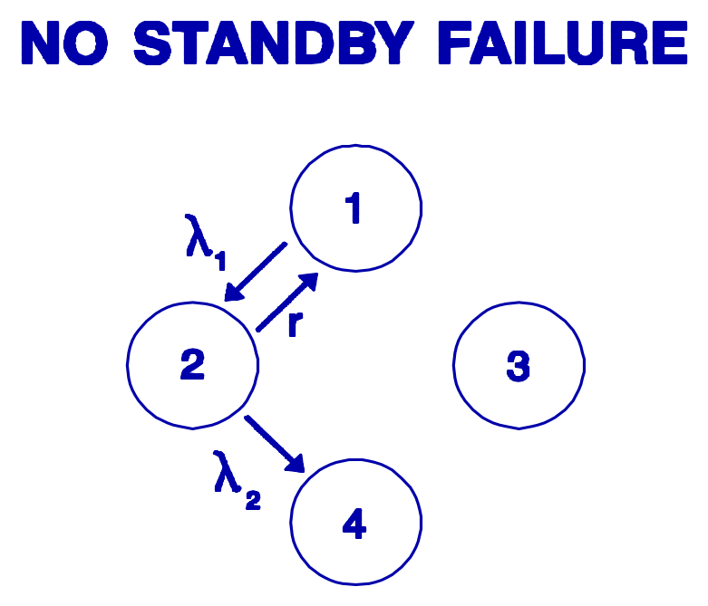
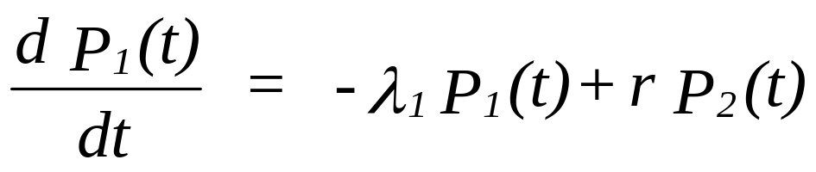
Standby System with Repair
No failures in standby
Chapter 9
Notes:
It is much easier to solve this problem if there are no failures while in standby mode. The student may wish to solve for the more difficult case.

Slide 20
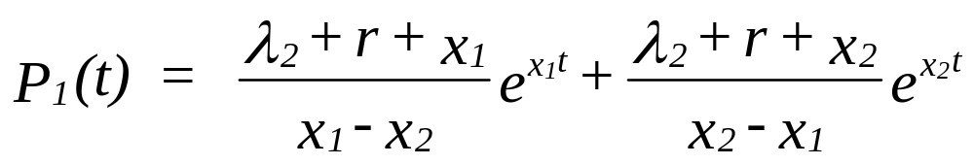
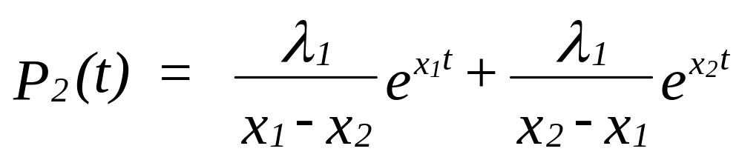
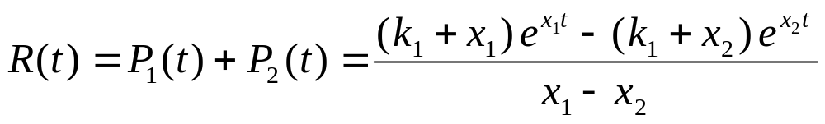
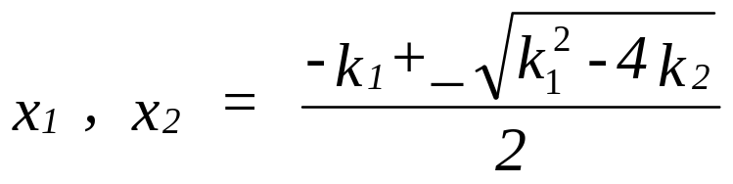
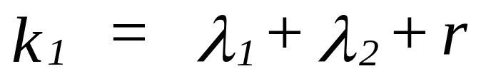
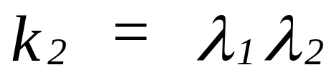
Standby System with Repair
No failures in standby - solution
Chapter 9
Notes:
The solution to the standby model with repair.

Slide 21
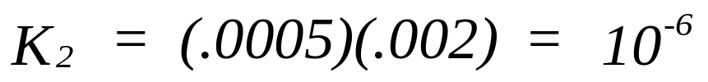
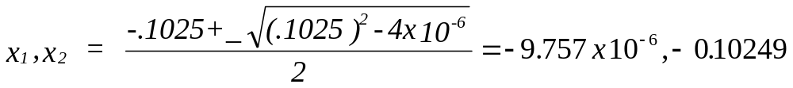
Standby System with Repair
No failures in standby-example
An on-board computer system has, through the use of
built-in-test equipment (BITE), the capability of being
restored when a failure occurs. A standby computer is
available for use whenever the primary fails.
λ₁ = .0005, r = .1, and λ₂ = .002 failures per hour.
Chapter 9
Notes:
You should duplicate the calculations to ensure your understanding of the solution to this model.

Slide 22

Standby System with Repair
No failures in standby-example
R(1000) = .99039
R(2000) = .98077
R(3000) = .97125
R(4000) = .96182
R(5000) = .95248
Chapter 9
Notes:
Once the reliability function has been found, we could plot the function over time. How would we find the MTTF, a design life or the median time to failure?

Slide 23


The End
I fix things in accordance with the lognormal probability distribution
Yes, but your MTTR is unacceptable!
Chapter 9
Notes:
How sad, the end of the chapter.

